Slide 1
Functional Dependencies and Normalization
DBMS

Slide 2
What will be discussed?
Introduction to Functional dependencies
Examples of Functional dependencies
Normalization
First Normal Form
Second Normal Form
Third Normal Form
Boyce-Codd Normal Form
Fourth Normal Form
Fifth Normal Form
Benefits of Normalization
Introduction to Denormalization
Denormalization Techniques
When to Denormalize
Conclusion

Slide 3
Introduction
Functional dependencies are a fundamental concept in database management systems.
Normalization is a process that uses functional dependencies to organize and structure database schemas.

Slide 4
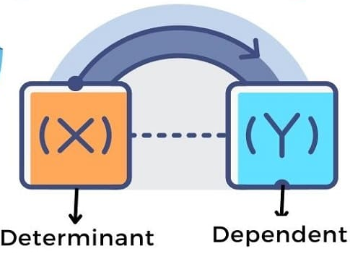
Functional Dependencies
Functional dependencies define the relationships between attributes in a relation.
A functional dependency represents a constraint stating that the values of certain attributes uniquely determine the values of other attributes.
Notation: X -> Y, where X is the determinant and Y is the dependent attribute(s).

Slide 5
Example of Functional Dependencies
Example: Consider a relation "Employee" with attributes (Employee ID, Employee Name, Department).
Functional dependencies:
Employee ID -> Employee Name
Employee ID -> Department
These dependencies indicate that given an Employee ID, we can determine the corresponding Employee Name and Department.

Slide 6
Normalization
Normalization is a process that Minimize data redundancy and anomalies in a database schema.
It involves decomposing relations into smaller, well-structured relations.
Normal forms (NF) provide guidelines for normalization.

Slide 7
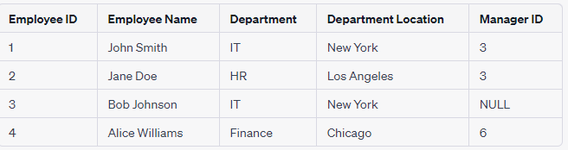
Consider the following "Employee" table with attributes (columns):
Employee Table (unnormalized):

Slide 8
First Normal Form (1NF)
1NF eliminates duplicate rows and ensures atomicity of attributes.
Each attribute must contain only atomic (indivisible) values.
Example: Splitting a relation with repeating groups into multiple relations.
To achieve 1NF, we need to ensure that each row is uniquely identifiable, usually by adding a primary key.

Slide 9
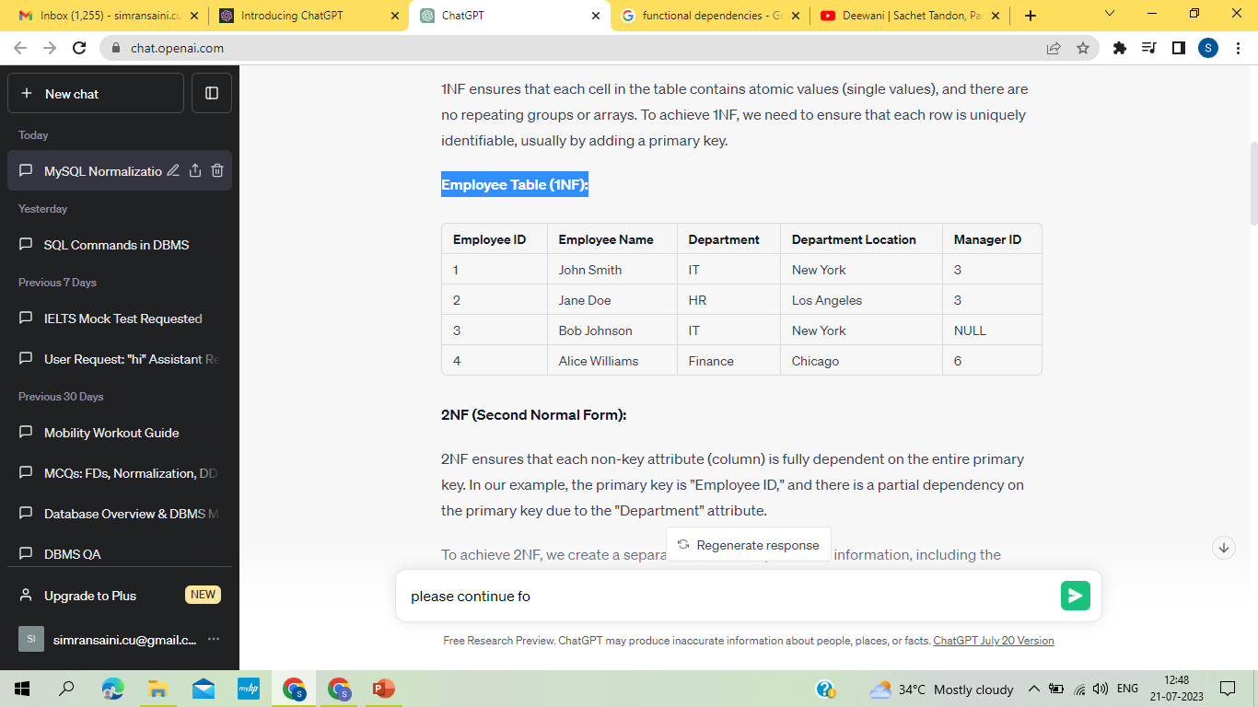
Employee Table (1NF):

Slide 10
Second Normal Form (2NF)
2NF eliminates partial dependencies.
A relation is in 2NF if it is in 1NF and has no partial dependencies.
Partial dependency: When a non-key attribute depends on only part of the primary key.
Example: Splitting a relation into two relations to eliminate partial dependencies.
In our example, the primary key is "Employee ID," and there is a partial dependency on the primary key due to the "Department" attribute.
To achieve 2NF, we create a separate table for "Department" information, including the "Department" and "Department Location," and link it to the "Employee" table using a foreign key.

Slide 11
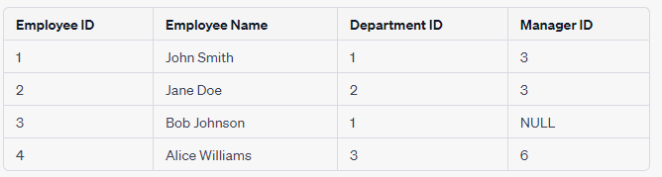
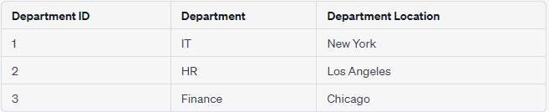
Employee Table (2NF):
Department Table (2NF):

Slide 12
Third Normal Form (3NF)
3NF eliminates transitive dependencies.
A relation is in 3NF if it is in 2NF and has no transitive dependencies.
Transitive dependency: When a non-key attribute depends on another non-key attribute.
Example: Splitting a relation into multiple relations to remove transitive dependencies.
3NF ensures that there are no transitive dependencies between non-key attributes. In our example, there is a transitive dependency between "Manager ID" and "Employee Name" based on "Employee ID."
To achieve 3NF, we create a separate table for "Manager" information and link it to the "Employee" table using a foreign key.

Slide 13

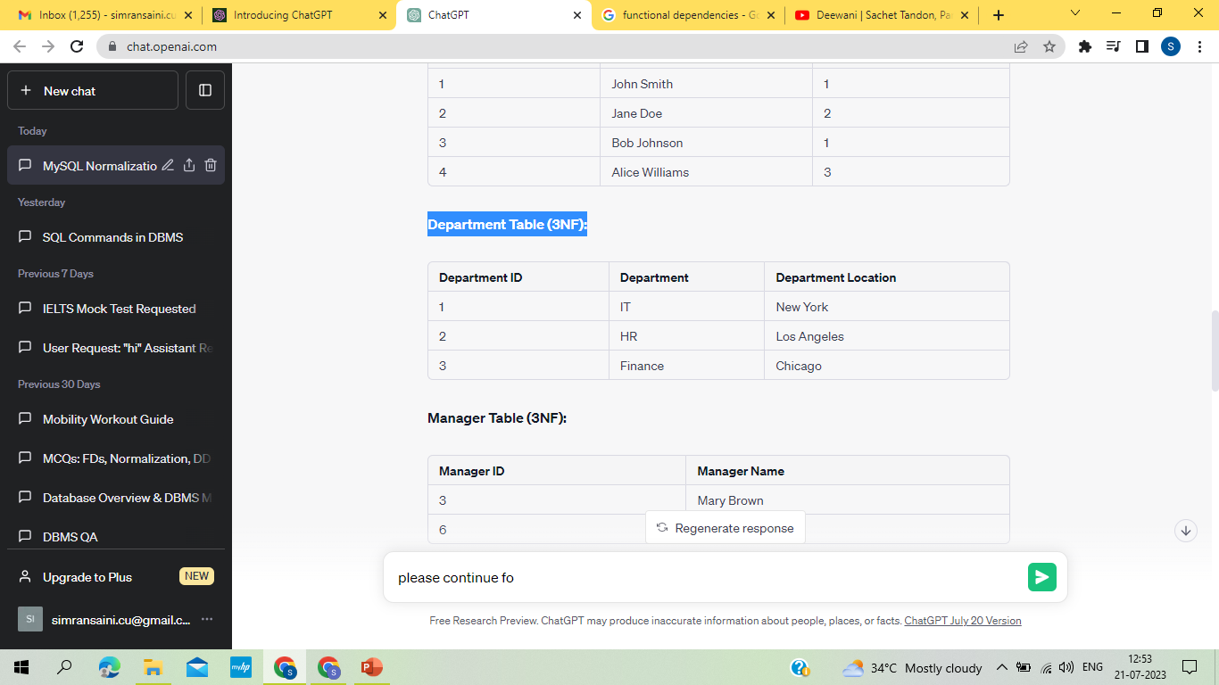
Employee Table (3NF):
Department Table (3NF):

Slide 14
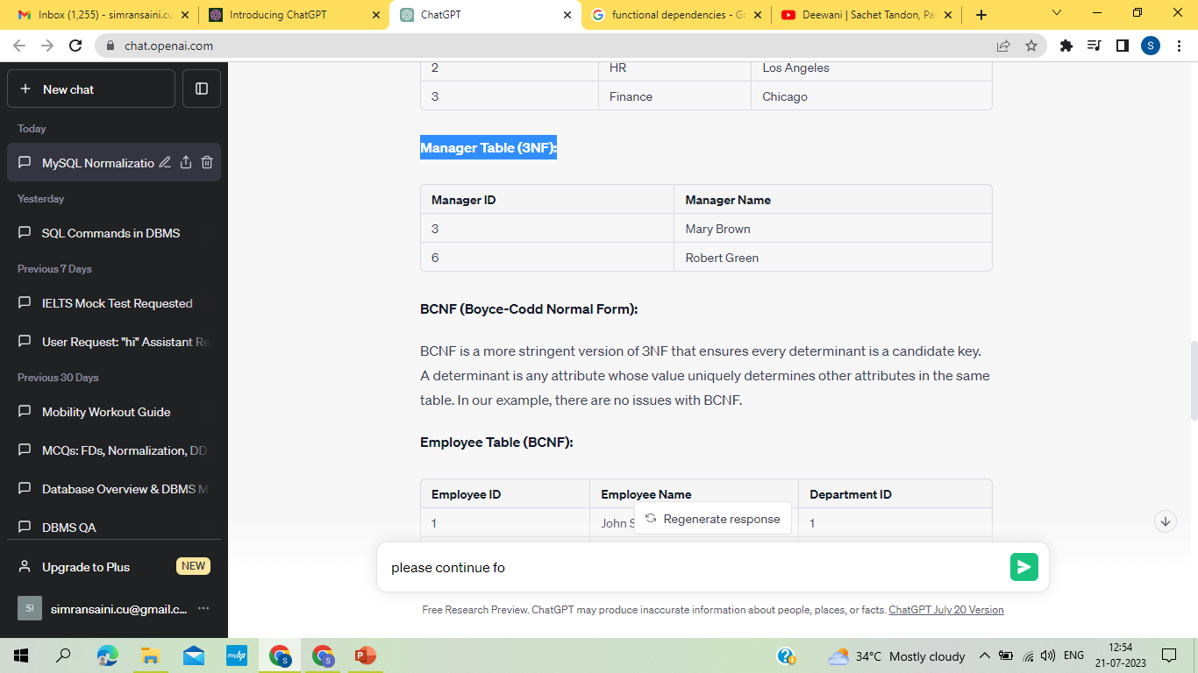
Manager Table (3NF):

Slide 15
Boyce-Codd Normal Form (BCNF)
BCNF eliminates non-trivial dependencies.
A relation is in BCNF if for every non-trivial functional dependency X -> Y, X is a superkey.
Non-trivial dependency: The determinant and dependent attribute(s) are not the same.
Example: Decomposing a relation to satisfy BCNF requirements.
BCNF is a more stringent version of 3NF that ensures every determinant is a candidate key. A determinant is any attribute whose value uniquely determines other attributes in the same table. In our example, there are no issues with BCNF.

Slide 16
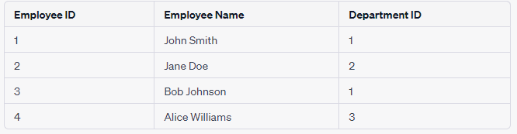

Employee Table (BCNF):
Department Table (BCNF):

Slide 17
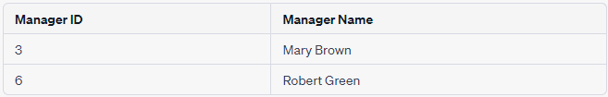
Manager Table (BCNF):

Slide 18
4NF (Fourth Normal Form):
4NF deals with multi-valued dependencies. It ensures that there are no non-trivial multi-valued dependencies between attributes.
In our example, there are no multi-valued dependencies, so the tables remain the same as in BCNF.

Slide 19
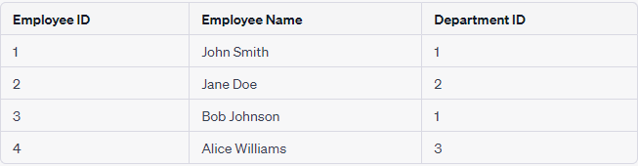
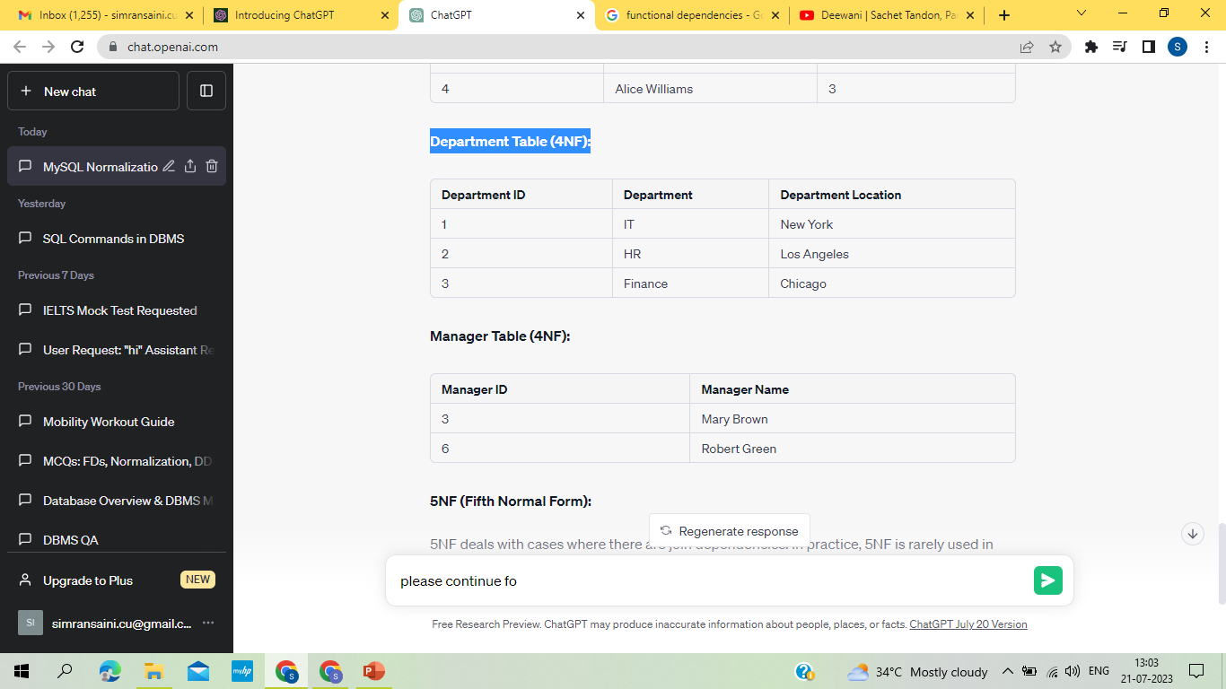
Employee Table (4NF):
Department Table (4NF):

Slide 20
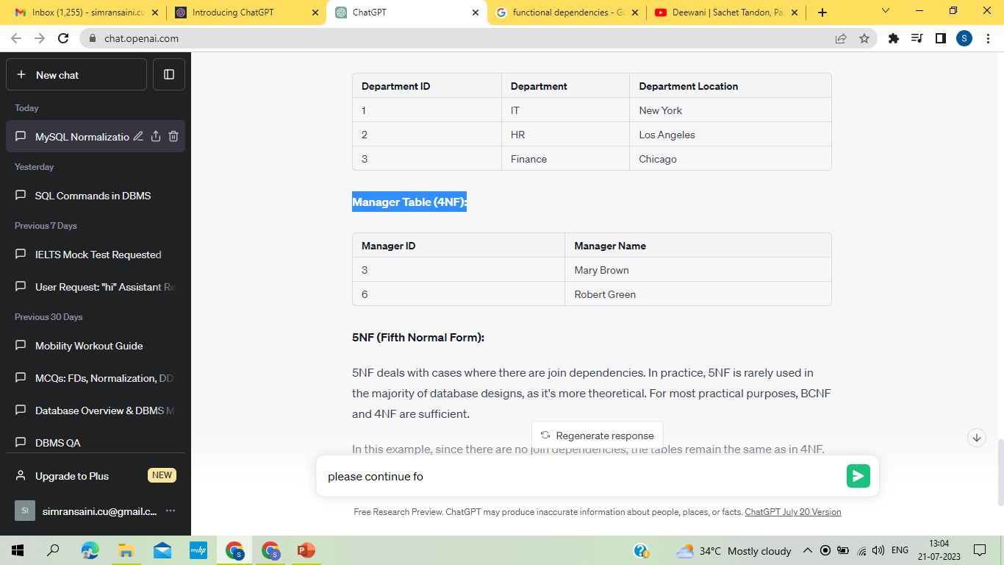
Manager Table (4NF):

Slide 21
5NF (Fifth Normal Form):
5NF deals with cases where there are join dependencies. In practice, 5NF is rarely used in the majority of database designs, as it's more theoretical. For most practical purposes, BCNF and 4NF are sufficient.
In this example, since there are no join dependencies, the tables remain the same as in 4NF.
Remember that normalization should be tailored to the specific requirements and characteristics of your data. While normalization helps to minimize redundancy and improve data integrity, excessively normalizing a database can lead to complex queries and reduced performance, so it's essential to strike a balance based on the actual needs of your application.

Slide 22
Benefits of Normalization
Improved data integrity: Reduces anomalies and inconsistencies.
Reduced redundancy: Minimizes data duplication, saving storage space.
Simplified data management: Clearer structure and relationships.
Improved query performance: Efficient retrieval and manipulation of data.

Slide 23
Denormalization
Denormalization is the process of intentionally introducing redundancy into a database design.
It aims to improve query performance or simplify data retrieval.
Denormalization relaxes the normalization principles.

Slide 24

Example:
Let's use the previous example of the "Employee," "Department," and "Manager" tables and demonstrate denormalization.
Employee Table (Normalized):

Slide 25
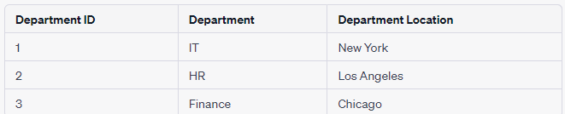
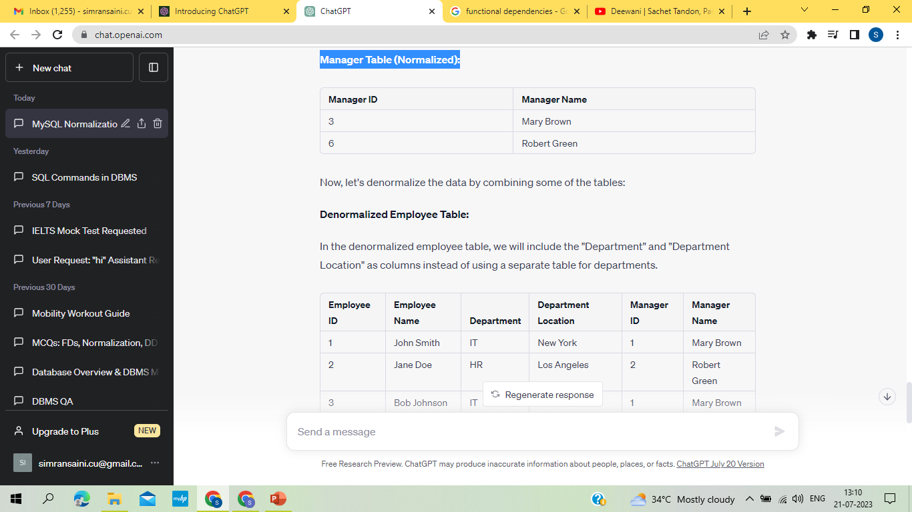
Department Table (Normalized):
Manager Table (Normalized):

Slide 26
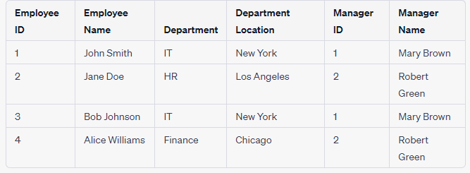
Denormalized Employee Table:
In the denormalized employee table, we will include the "Department" and "Department Location" as columns instead of using a separate table for departments.
In the denormalized employee table, we have included the "Department" and "Department Location" columns directly from the "Department" table, and we have also added the "Manager Name" column from the "Manager" table, based on the "Manager ID" in the employee table.

Slide 27
Why Denormalize?
Performance optimization: Denormalization can improve query performance by reducing the need for complex joins and calculations.
Read-heavy applications: Denormalization is beneficial in applications where data retrieval is more frequent than updates.
Simplified data model: Denormalization can simplify the data model by reducing the number of tables and relationships.

Slide 28
Denormalization Techniques
Duplicating data: Storing redundant data in multiple tables to avoid complex joins.
Derived attributes: Introducing additional attributes calculated from existing data.
Summary tables: Pre-computing and storing aggregated data for faster retrieval.
Materialized views: Creating pre-calculated views for commonly used queries.

Slide 29
Trade-offs
Data redundancy: Denormalization increases redundancy, which can lead to data inconsistencies if not managed carefully.
Update anomalies: Redundant data requires careful maintenance to ensure consistency across copies.
Scalability and flexibility: Denormalization can make database evolution and structural changes more complex.
Careful planning and monitoring are necessary to mitigate these trade-offs.

Slide 30
When to Denormalize
Consider denormalization when it significantly improves query performance and the benefits outweigh the potential drawbacks.
Analyze specific performance bottlenecks and usage patterns before making denormalization decisions.
Evaluate the impact on data integrity, maintenance complexity, and future scalability.

Slide 31
Examples of Denormalization
Duplicating attributes: Storing redundant data in multiple tables for faster retrieval.
Introducing summary tables: Storing pre-aggregated data to avoid expensive calculations.
Caching frequently accessed data: Storing copies of frequently accessed data for faster retrieval.

Slide 32
Conclusion
Functional dependencies provide a basis for normalization in database design.
Normalization eliminates redundancy and ensures a well-structured database schema.
By following normalization principles, we can achieve data integrity, efficiency, and maintainability.
Denormalization is a technique to improve performance and simplify data retrieval.
It involves introducing redundancy into the database design.
Careful consideration of trade-offs and analysis of specific requirements is crucial in deciding when and how to denormalize.

Slide 33
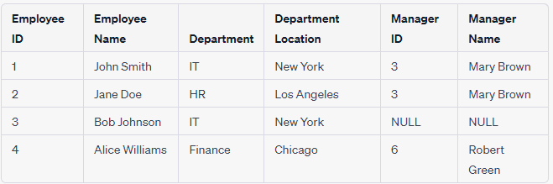
Practice for Students:
Unnormalized Table (Employees):

